Slide 1

Advanced Persistent Threat (APT) Detection and Mitigation Framework
R25-037

Slide 2
Team Members
Supervisor: Dr. Harinda Fernando
Co-supervisor: Mr. Amila Senarathne
Student Name | Student ID
H.P.D.D.M.Wickramasinghe | IT21825682
D.L.K.L.Gangaboda | IT21812330
N.H.S.Chandrasekara | IT21812880

Slide 3
Introduction
Our research focuses on developing an Advanced Persistent Threat (APT) Detection and Mitigation Framework, addressing the increasing complexity of cyberattacks that bypass traditional security measures. By using machine learning techniques, our solution tackles every stage of the APT lifecycle, including reconnaissance, delivery, exploitation, and execution. Each phase is meticulously analyzed, using innovative approaches such as anomaly-based clustering for early threat detection, BERT models for phishing email identification, and reinforcement learning for dynamic profiling and mitigation. This modular framework offers real-time threat intelligence, adaptability, and proactive defense, ensuring protection against evolving cyber threats.

Slide 4

Research Problem
Advanced Persistent Threats (APTs) are targeted, persistent cyberattacks that evade traditional security mechanisms. They require innovative detection and mitigation methods due to their evolving tactics.

Slide 5
Research Objectives
Develop a modular, machine-learning-based APT Detection and Mitigation framework.
Address each APT lifecycle stage- reconnaissance, delivery, exploitation, and execution.

Slide 6
Overall Solution
The framework integrates specialized ML techniques for each lifecycle stage, feeding into a centralized threat intelligence system. This system enables real-time detection, mitigation, and adaptability to evolving threats.

Slide 7
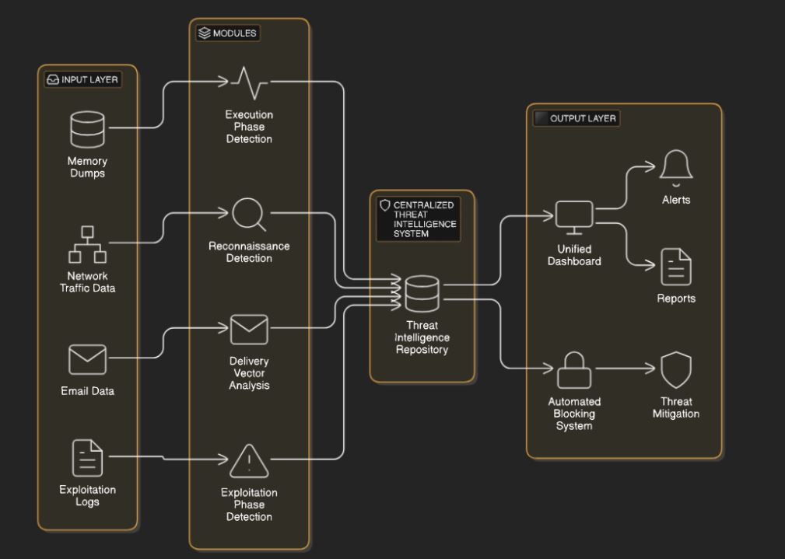
Overall System Diagram

Slide 8
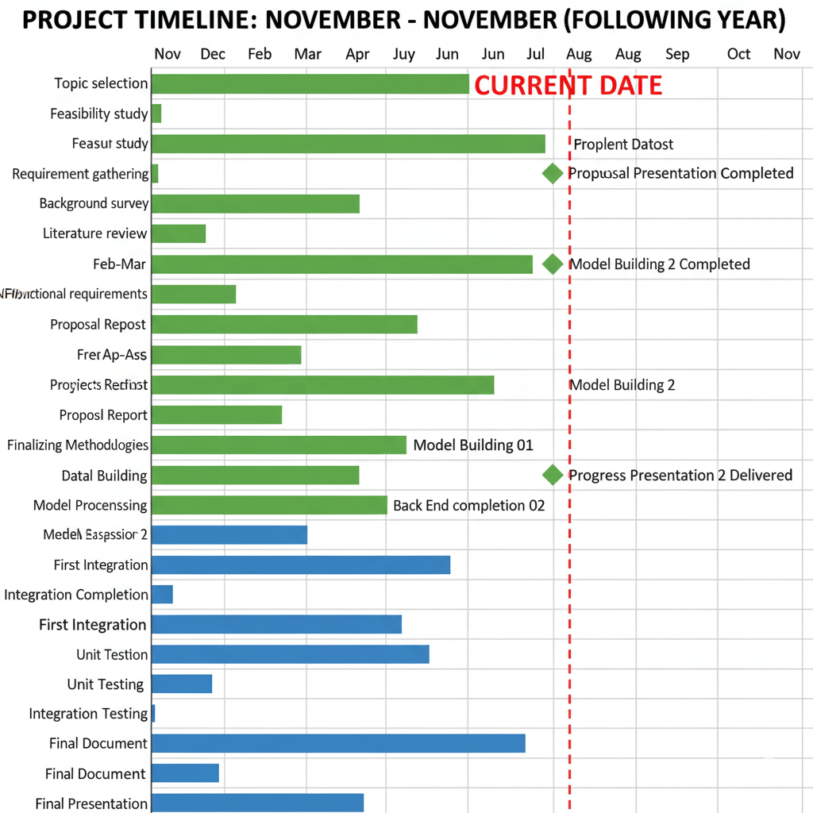
Gantt Chart

Slide 9

IT21812880 |N.H.S Chandrasekara
Reconnaissance Detection using Anomaly Based Clustering
IT21812880 | N.H.S Chandrasekara | R25-037

Slide 10
Introduction and Background
Cyberattack Reconnaissance Detection • Reconnaissance is the initial stage of cyberattacks, gathering information about target systems. • Traditional methods rely on signature-based systems, ineffective against new threats. • Anomaly-based clustering techniques identify deviations from normal network traffic, enabling early threat detection. • Study focuses on developing an advanced anomaly-based clustering framework for reconnaissance detection.
IT21812880 | N.H.S Chandrasekara | R25-037

Slide 11

Research Question
How can adaptive clustering improve APT detection during the reconnaissance stage?
IT21812880 | N.H.S Chandrasekara | R25-037

Slide 12
Research Gap
While anomaly-based clustering has been applied in other domains, its use in reconnaissance detection remains underexplored. Existing methods either lack scalability or generate high false-positive rates, limiting their practical application. This research aims to fill this gap by creating a novel clustering framework optimized for real-world network environments.
IT21812880 | N.H.S Chandrasekara | R25-037

Slide 13
Objectives
Main-Objectives
This research aims to develop a real-time anomaly-based clustering framework to detect reconnaissance activities in network traffic. It focuses on minimizing false positives, ensuring high detection accuracy, and identifying abnormal traffic patterns to prevent potential attacks.
Sub-Objectives
Collect and preprocess network traffic logs, focusing on metadata like port scans and DNS lookups.
Develop a feature extraction pipeline to identify reconnaissance activity patterns.
Implement clustering model ( DBSCAN) with incremental learning for live data analysis.
Visualize detected anomalies in a real-time dashboard to enhance monitoring.
IT21812880 | N.H.S Chandrasekara | R25-037

Slide 14
Comparision
Research | Year | Technique / Model | Dataset | Accuracy
Our System | 2025 | Anomaly Based Clustering | Kaggle NSL-KDD (Network Intrusion Detection) | 91%
Li, Y., Liu, X., & Wang, Z. (2023). Unsupervised anomaly detection in network traffic using improved clustering techniques. Journal of Network and Computer Applications, 214, 103620. [1] | 2023 | Enhanced k-Means clustering | CICIDS2017 | ~90%
Aljawarneh, S., Aldwairi, M., & Yassein, M. B. (2018). Anomaly-based intrusion detection system through feature selection and building efficient rules using the particle swarm optimization algorithm. Journal of Ambient Intelligence and Humanized Computing, 9(6), 1731-1747 .[2] | 2018 | Clustering with PSO optimization | NSL-KDD | ~89.2%
Bhuyan, M. H., Bhattacharyya, D. K., & Kalita, J. K. (2015). An effective unsupervised network anomaly detection method. International Journal of Communication Systems, 28(13), 2161-2177. [3] | 2015 | Density-based clustering (DBSCAN) | NSL-KDD | ~88.5%
Chandola, V., Banerjee, A., & Kumar, V. (2009). Anomaly detection: A survey. ACM Computing Surveys (CSUR), 41(3), 1-58.[4] | 2009 | Clustering-based anomaly detection (various) | Multiple (e.g., KDD Cup 1999) | ~87% (avg. on probes)
Portnoy, L., Eskin, E., & Stolfo, S. (2001). Intrusion detection with unlabeled data using clustering. In Proceedings of the ACM Workshop on Data Mining Applied to Security (DMSA-2001) (pp. 5-8). [5] | 2001 | Clustering (k-Means variants) | KDD Cup 1999 | ~85%

Slide 15
Methodology
System Architecture
Tools and Technologies
Requirements
IT21812880 | N.H.S Chandrasekara | R25-037

Slide 16
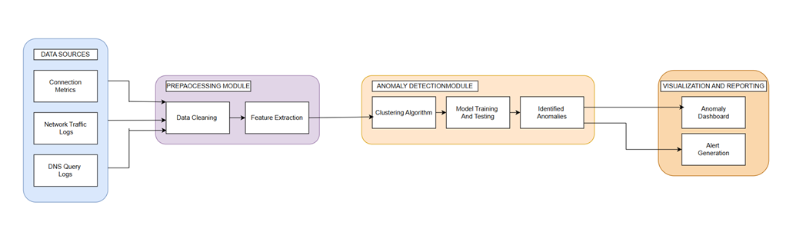
System Architecture
IT21812880 | N.H.S Chandrasekara | R25-037

Slide 17
Dataset
The "Network Intrusion Detection" dataset, derived from the NSL-KDD dataset (an improved version of KDD Cup 1999, originally released in 2009), is a benchmark for intrusion detection with 41 features, 38 quantitative (e.g., duration, src_bytes, serror_rate) and 3 qualitative (e.g., protocol_type, service, flag)—capturing TCP/IP connection attributes like byte counts, error rates, and connection status. It totals 44,737 data 22,193 training records and 22,544 testing records, simulating military network traffic.[6]

Slide 18
Current Progress
•Port Scan Detection with DBSCAN
•Port Scan Feature Extraction
•Live Network Monitoring with DNS Analysis & Port Scan
•IP Blocking & Firewall Rules
•Web Dashboard with Port Scanning Analysis
•CSV File Analysis
IT21812880 | N.H.S Chandrasekara | R25-037

Slide 19
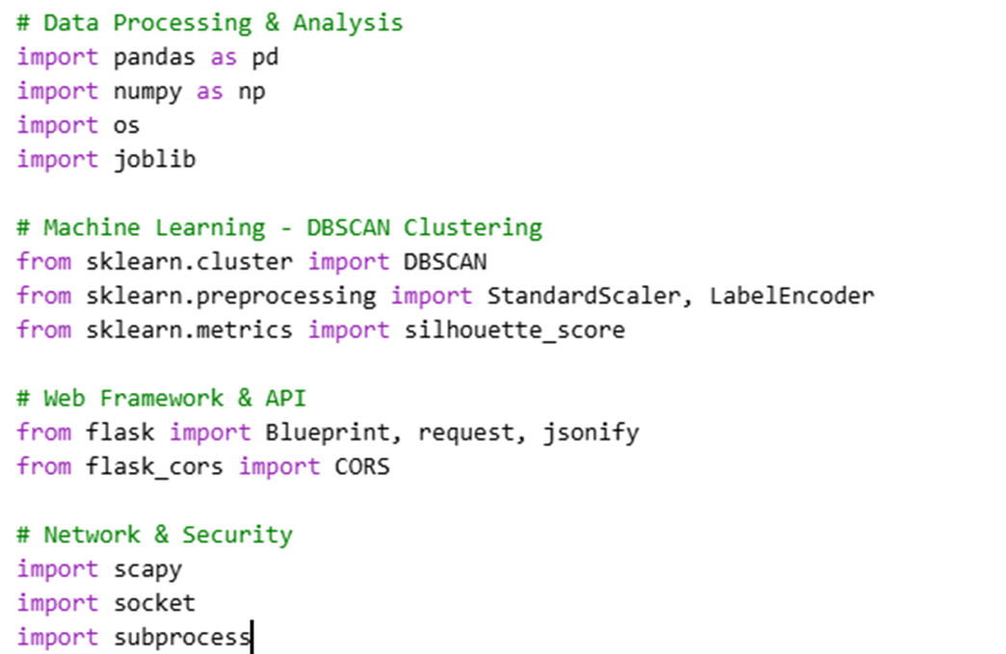
Project Evidence - Imports
IT21812880 | N.H.S Chandrasekara | R25-037

Slide 20
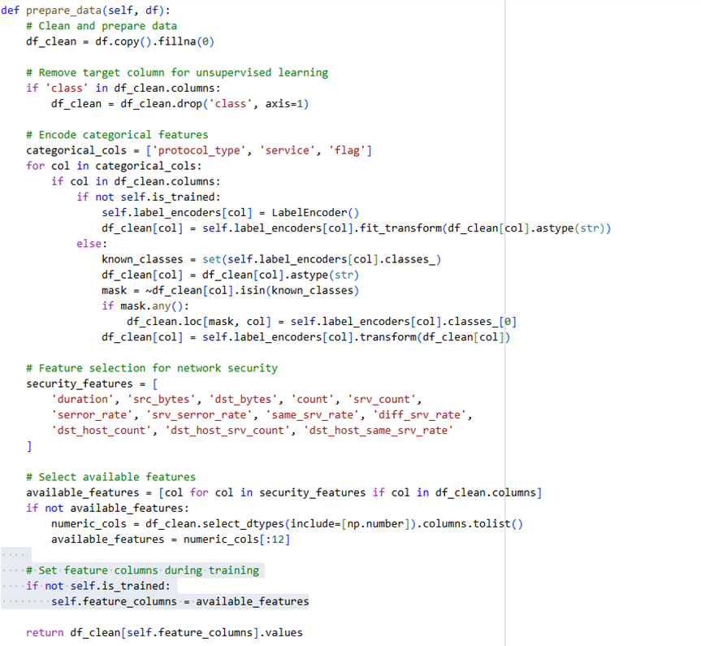
Project Evidence - Pre Processing
IT21812880 | N.H.S Chandrasekara | R25-037

Slide 21
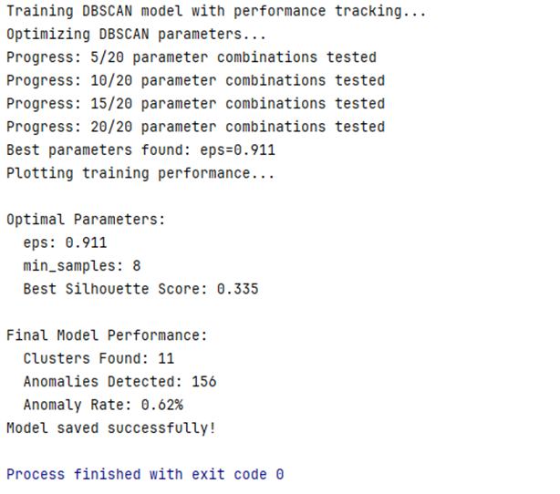
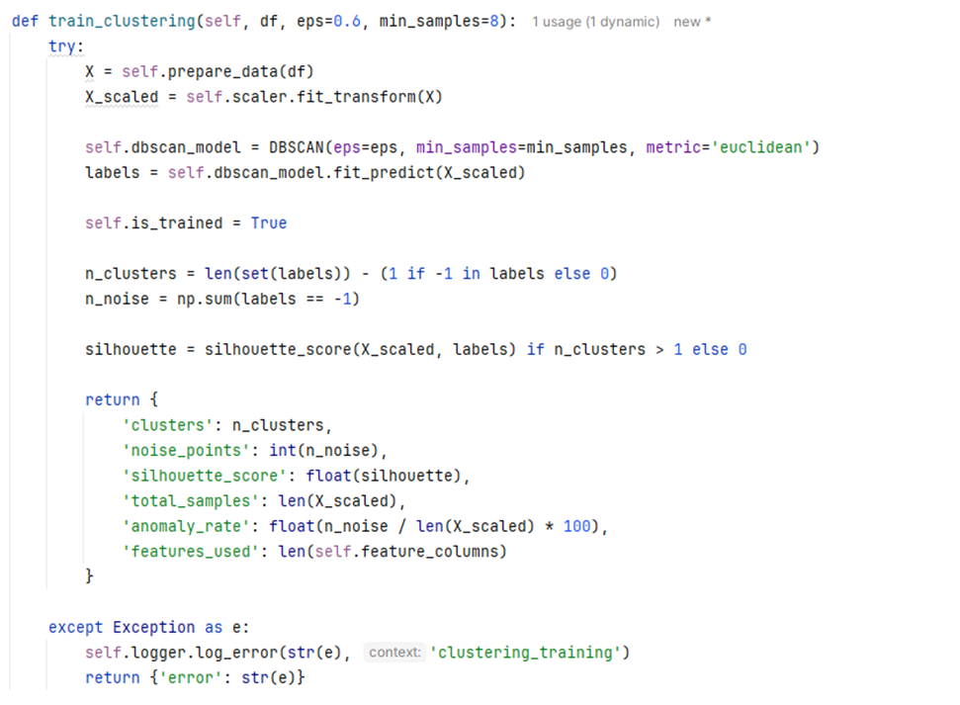
Project Evidence - Model Train
IT21812880 | N.H.S Chandrasekara | R25-037

Slide 22
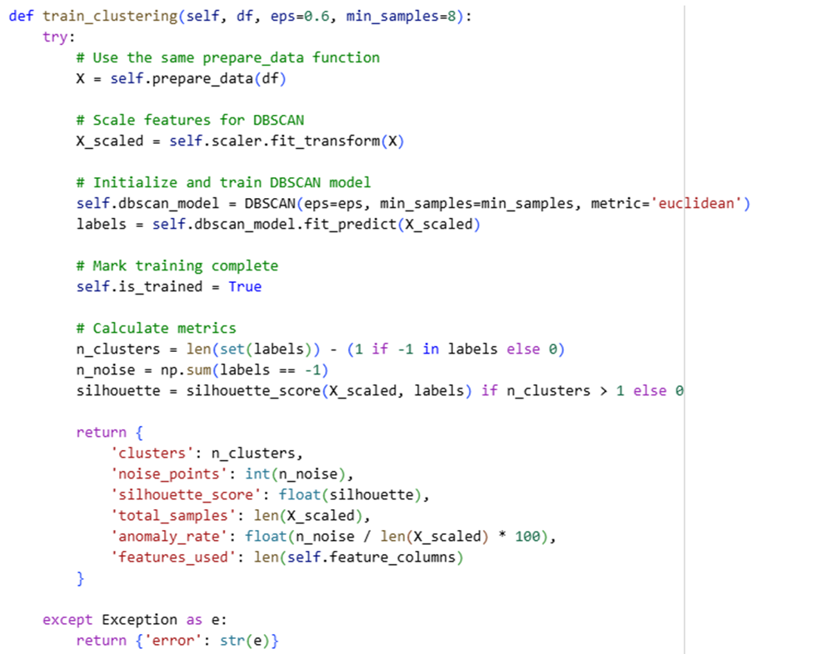
Project Evidence -Model Building
IT21812880 | N.H.S Chandrasekara | R25-037

Slide 23
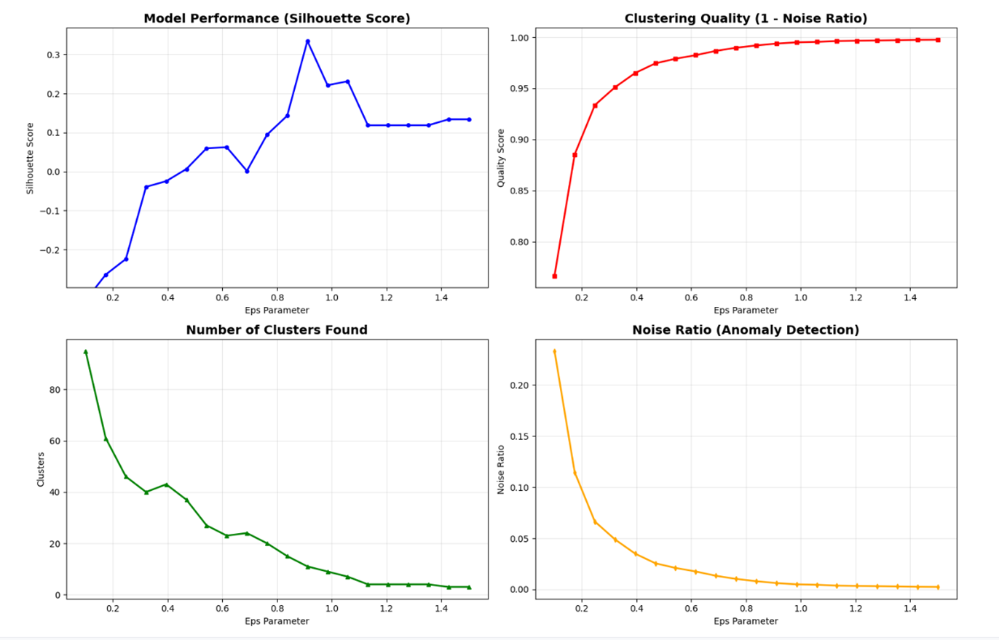
Project Evidence - Model Training Performance

Slide 24
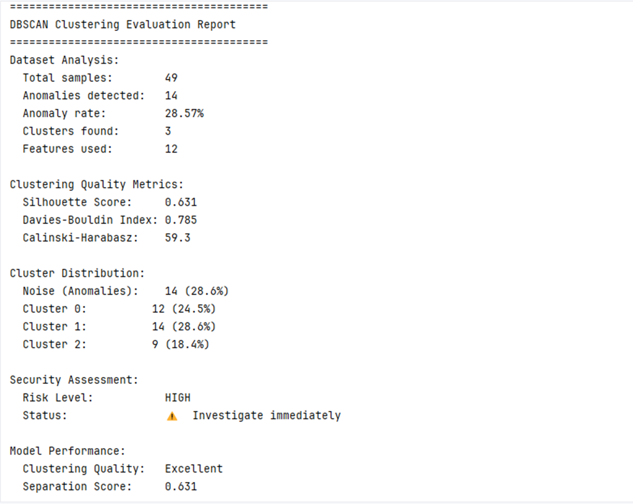
Project Evidence - Clustering Evaluation Report

Slide 25
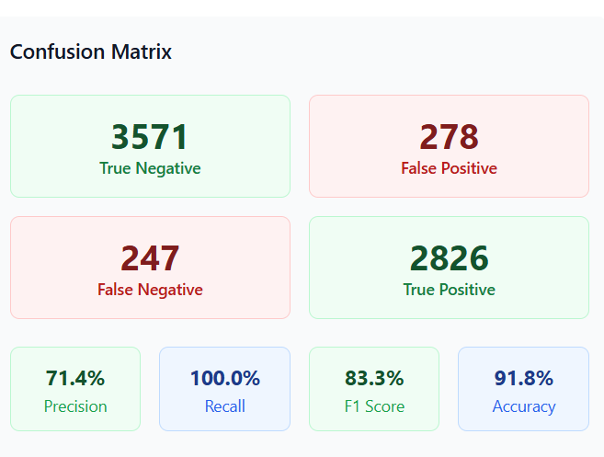
Project Evidence - Confusion Matrix

Slide 26
Future Work
DBSCAN Parameter Optimization
Advanced Port Scan Pattern Recognition
Automated Response System
Network Forensics Module
Report Generation

Slide 27
Requirements
Functional Requirements
Real-time processing of network traffic logs.
Accurate detection of reconnaissance activities.
Non-Functional Requirements
Accuracy
Performance
Reliability
Scalability
IT21812880 | N.H.S Chandrasekara | R25-037

Slide 28
Tools, Technologies, and Algorithms
Tools: VS Code, Python, scikit-learn, pandas, numpy, joblib
Technologies:
Algorithms: DBSCAN clustering, anomaly detection, network traffic analysis
Frontend: React.js, JavaScript, HTML, CSS, Tailwind CSS
Backend: Flask, Python
Database: CSV file storage
Network: HTTP/REST APIs, DNS monitoring
Deployment: Local development server
IT21812880 | N.H.S Chandrasekara | R25-037

Slide 29
References
[1] Li, Y., Liu, X., & Wang, Z. (2023). Unsupervised anomaly detection in network traffic using improved clustering techniques. Journal of Network and Computer Applications, 214, 103620 https://arxiv.org/html/2503.08293v1
[2] Aljawarneh, S., Aldwairi, M., & Yassein, M. B. (2018). Anomaly-based intrusion detection system through feature selection analysis and building efficient rules using the particle swarm optimization algorithm. Journal of Ambient Intelligence and Humanized Computing, 9(6), 1731-1747. https://www.researchgate.net/publication/315642556_Anomaly-based_intrusion_detection_system_through_feature_selection_analysis_and_building_hybrid_efficient_model
[3] Bhuyan, M. H., Bhattacharyya, D. K., & Kalita, J. K. (2015). An effective unsupervised network anomaly detection method. International Journal of Communication Systems, 28(13), 2161-2177. https://www.researchgate.net/publication/307936101_Network_Anomaly_Detection_A_Machine_Learning_Perspective
[4] Chandola, V., Banerjee, A., & Kumar, V. (2009). Anomaly detection: A survey. ACM Computing Surveys (CSUR), 41(3), 1-58.
http://cucis.ece.northwestern.edu/projects/DMS/publications/AnomalyDetection.pdf
[6] https://www.kaggle.com/datasets/sampadab17/network-intrusion-detection
IT21812880 | N.H.S Chandrasekara | R25-037

Slide 30

IT21812330 |D.L.K.L Gangaboda
Delivery vector analysis through phishing email detection
IT21812330 | D.L.K.L.Gangaboda | R25-037

Slide 31
Research Question
How can phishing detection models enhance APT delivery phase security?
IT21812330 | D.L.K.L.Gangaboda | R25-037

Slide 32
Research Gap
Most neural network-based email classification methods are designed for offline batch learning rather than continuous online processing. Existing models often require high computational resources, making them inefficient for real-time deployment in large-scale or resource-limited environments. They also lack mechanisms to adapt to concept drift, where email content and spam tactics evolve over time. Furthermore, limited studies evaluate the balance between efficiency and accuracy when using neural networks for online email classification.so there is a gap in developing efficient neural network approaches for real-time email classification
IT21812330 | D.L.K.L.Gangaboda | R25-037

Slide 33



Comparisons
Requirement | Research [1] | Research [2] | Research [3] | Proposed System
Adaptability to evolving phishing techniques
Use of both text and metadata features
Nueral network based ML Model (BiLSTM/CNN/BERT) | Bert model | NLP/KNN Model | LLM/Bert Model
Continuous self-retraining on new phishing samples
IT21812330 | D.L.K.L.Gangaboda | R25-037

Slide 34
Comparisons
Research 1 - https://www.researchgate.net/publication/393016953_Phishing_Email_Detection_Using_Natural_Language_Processing_Techniques
Research 2 - https://www.researchgate.net/publication/394957104_Features_Analysis_of_all_Email_Components_for_Phishing_Detection
Research 3 - https://www.researchgate.net/publication/332593353_PhAttApp_A_Phishing_Attack_Detection_Application
IT21812330 | D.L.K.L.Gangaboda | R25-037

Slide 35
Objectives
Main Objective
Develop a hybrid deep learning model using Bi-directional LSTM for phishing and spam email detection, and implement a self-updating system for continuous learning with newly detected harmful emails.
Sub-Objectives
1.Collect a diverse dataset of phishing and legitimate emails, including text and metadata.
2.Model Development
Implement a BiLSTM layer to capture sequential and contextual relationships in email text.
Integrate metadata features into the model architecture for improved accuracy.
3.Model Training and Evaluation
4.System Integration
Develop Python scripts to connect the model with an email filtering/monitoring system.
Enable real-time detection of harmful or suspicious emails.
Connect gmail api to get emails real time, classify and finetune model on users feedback
5.Self-Retraining Mechanism
6.Mitigation
Labelling the spams in red to warn the users
IT21812330 | D.L.K.L.Gangaboda | R25-037

Slide 36
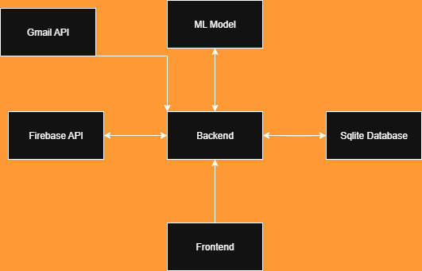
System Architecture
IT21812330 | D.L.K.L.Gangaboda | R25-037

Slide 37
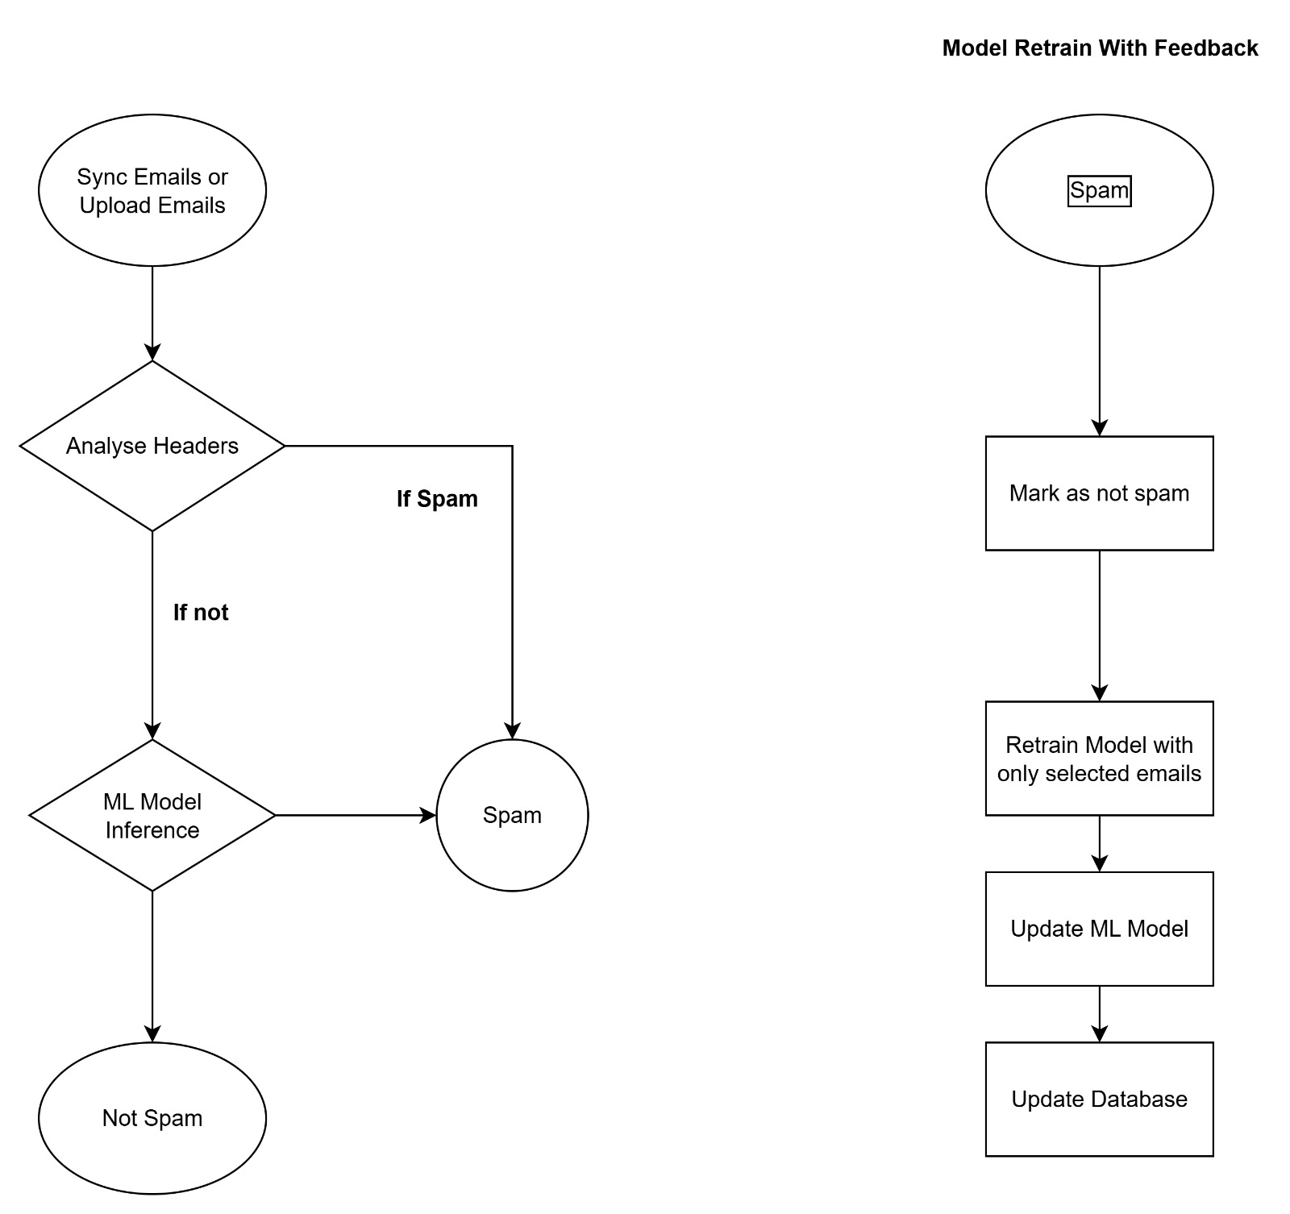
Architecture
IT21812330 | D.L.K.L.Gangaboda | R25-037

Slide 38

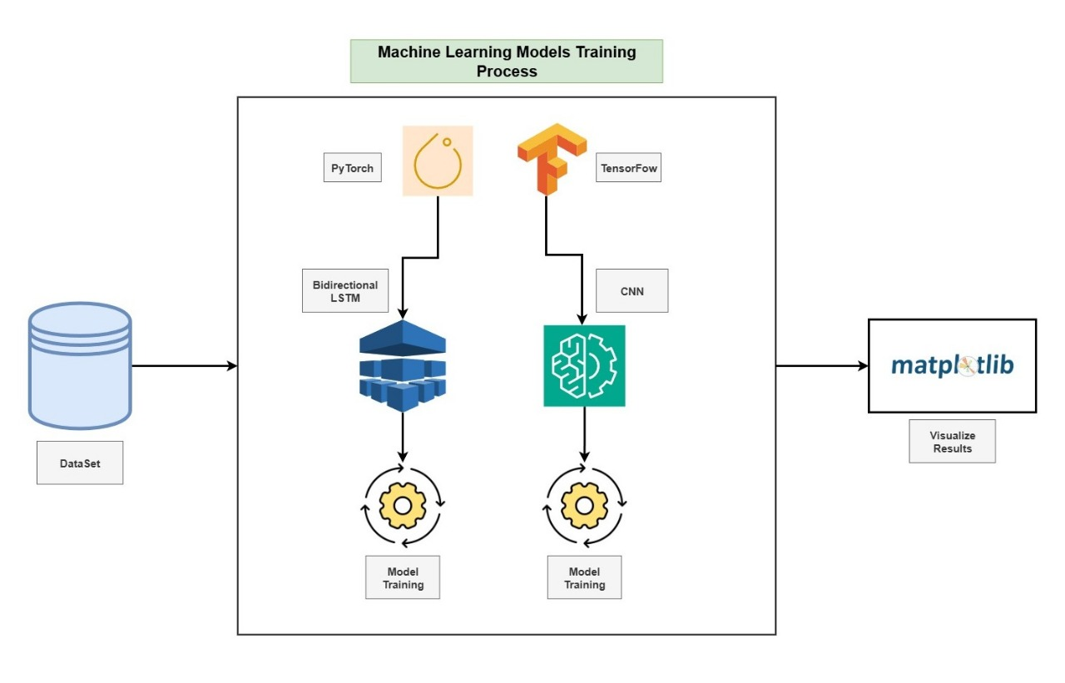
Machine Learning Process
IT21812330 | D.L.K.L.Gangaboda | R25-037

Slide 39
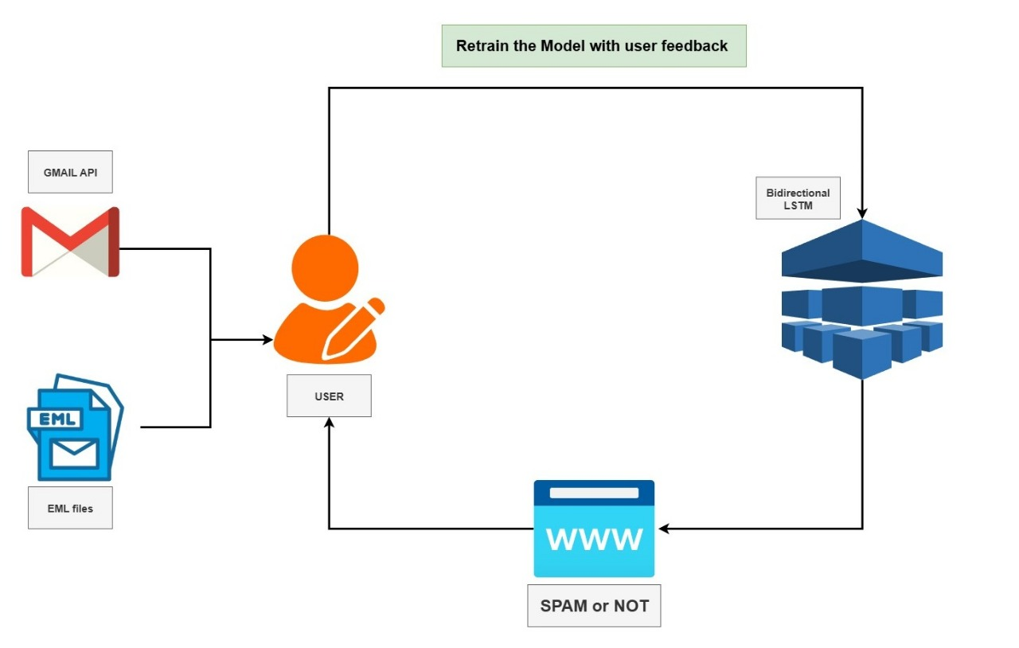
Machine Learning Process
IT21812330 | D.L.K.L.Gangaboda | R25-037

Slide 40
Methodology
1. Dataset Collection
Collect a diverse dataset of phishing and legitimate emails, including:
Text (.env files)
Meta Data (mail security hedders)
Text Data Sets
https://www.kaggle.com/datasets/naserabdullahalam/phishing-email-dataset?select=phishing_email.csv
https://www.kaggle.com/api/v1/datasets/download/wanderfj/enron-spam
Metadata Data Sets
https://github.com/kregg34/EmailHeaderAnomalyDetection/tree/master
IT21812330 | D.L.K.L.Gangaboda | R25-037

Slide 41
2.Vocabulary Building
The Vocabulary class counts words across all processed texts.
3.Model Training (BI-directional LSTM)
Embedding Layer
Converts word indices → dense vectors.
Example: “win” (index 2) → [0.12, -0.45, 0.67, ...]
Bidirectional LSTM
Processes sequences both left-to-right and right-to-left.
Captures context like:
Forward: "win → money → now"
Backward: "now → money → win"
Attention Mechanism
Assigns higher weights to important words (e.g., "win", "money").
Outputs a weighted average representation of the sequence.
IT21812330 | D.L.K.L.Gangaboda | R25-037

Slide 42
4.Evaluation
Metrics used:
Accuracy.
Classification report (precision, recall, F1).
Confusion matrix (counts of correct/incorrect predictions).
5.Fine-Tuning with Feedback
The model is retrained on them using a smaller learning rate (so it doesn’t “forget” old knowledge).
Updated model is saved again.
IT21812330 | D.L.K.L.Gangaboda | R25-037

Slide 43
Tools, Technologies, and Algorithms
Tools:
Libraries for Preprocessing and Analysis:
pandas: For data manipulation and cleaning.
matplotlib: For data visualization.
Natural Language Processing (NLP):
Word2Vec: Tokenize emails and generate a vocabulary.
Deep Learning Frameworks:
PyTorch: For predesigned bidirectional LSTM model and as a framework to build the model
Machine Learning Libraries:
Scikit-learn: For evaluation metrics (precision, recall, F1 scores).
IT21812330 | D.L.K.L.Gangaboda | R25-037

Slide 44
Tools, Technologies, and Algorithms
Neural Networks (Deep Learning)
Using PyTorch for creating and training neural models.
Natural Language Processing (NLP)
Tokenization, text preprocessing, embeddings, and attention.
Sequence Modeling
BiLSTM to capture sequential word dependencies.
Database Integration
SQLite to maintain training history and enable incremental learning with new feedback.
Model Persistence
Saving/loading models with PyTorch (.pth) and vocabulary with Pickle (.pkl).
Backend Framework
Use Flask as backend framework
Frontend Framework
Use React as frontend framwork
IT21812330 | D.L.K.L.Gangaboda | R25-037

Slide 45
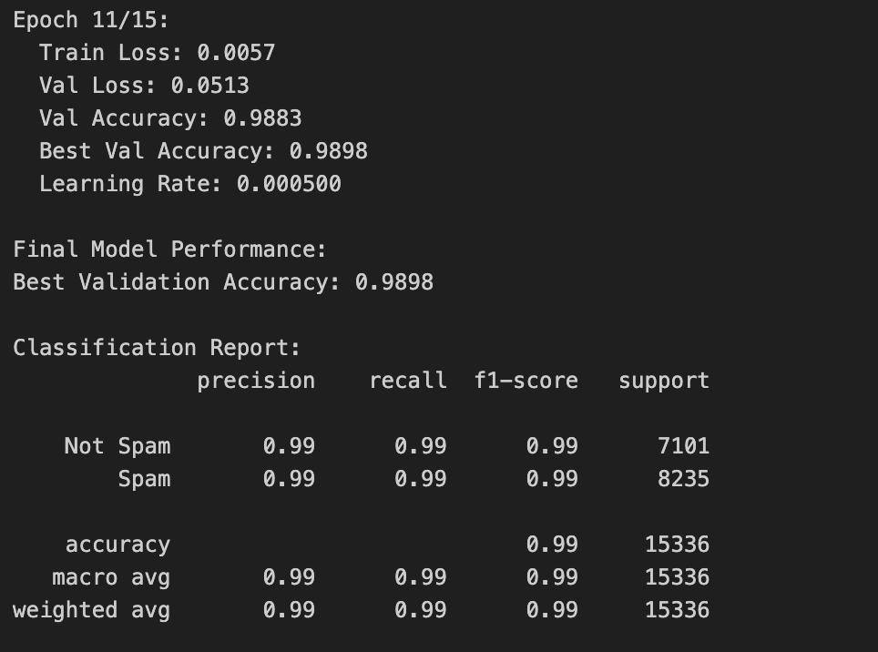
Project Evidence -Model Accuracy
IT21812330 | D.L.K.L.Gangaboda | R25-037

Slide 46
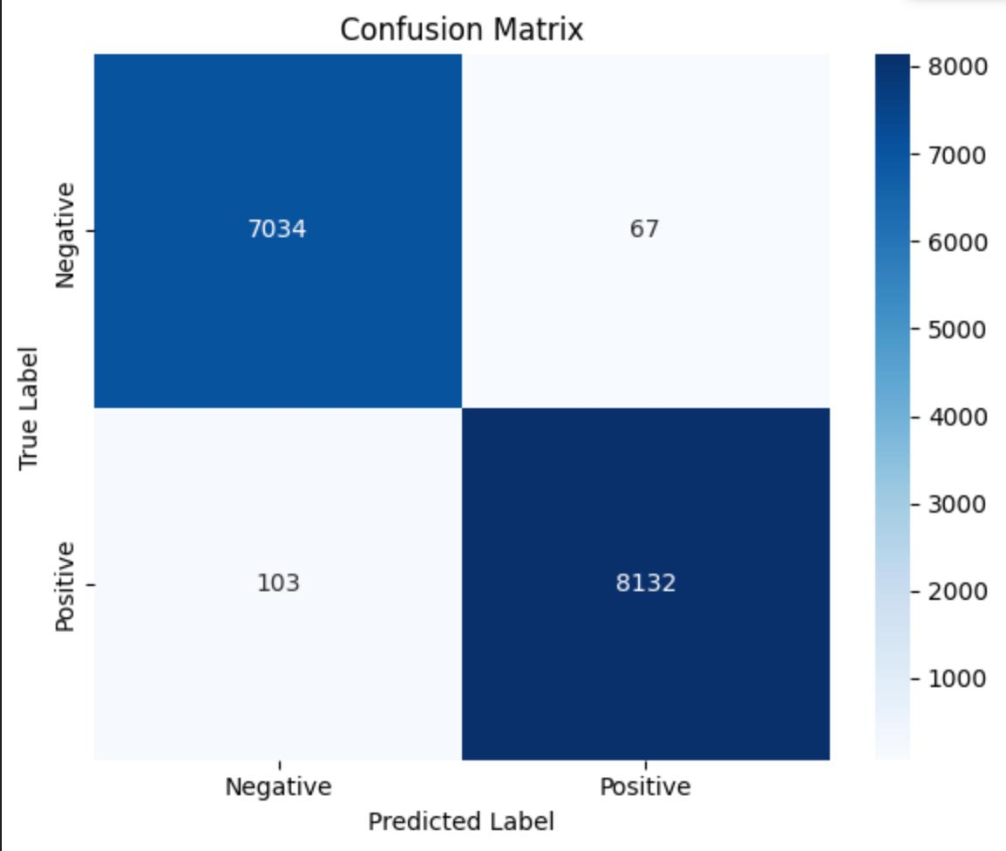
Project Evidence -Confusion Matrix
IT21812330 | D.L.K.L.Gangaboda | R25-037

Slide 47
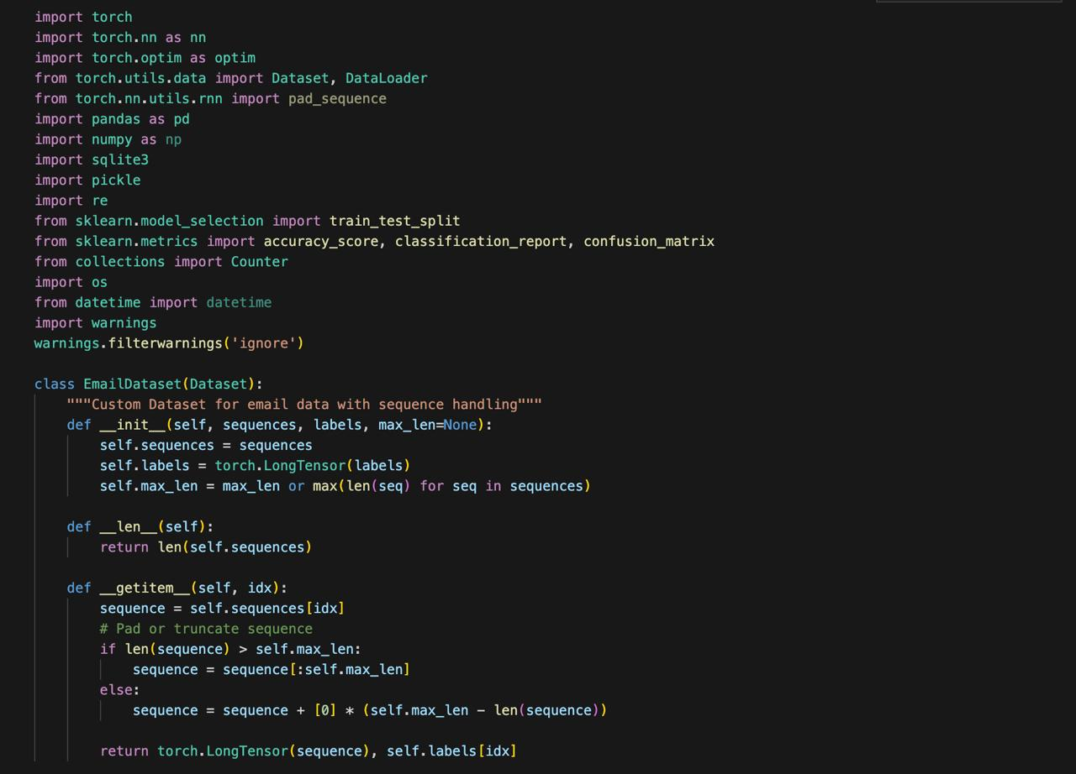
Project Evidence -Imports
Data Manipulation (pandas)
Preprocessing (sklearn)
Model Building (pytorch, sklearn)
Evaluation (sklearn.metrics)
Visualization (matplotlib)
IT21812330 | D.L.K.L.Gangaboda | R25-037

Slide 48
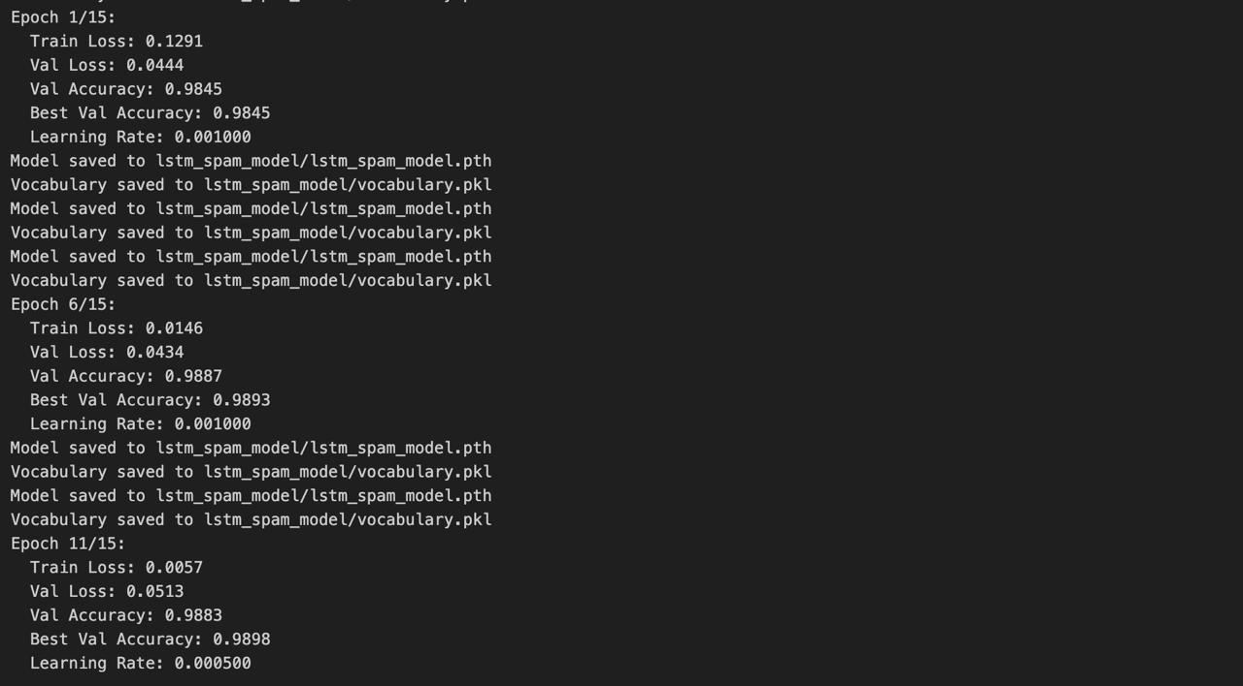
Evidences – Training
IT21812330 | D.L.K.L.Gangaboda | R25-037

Slide 49
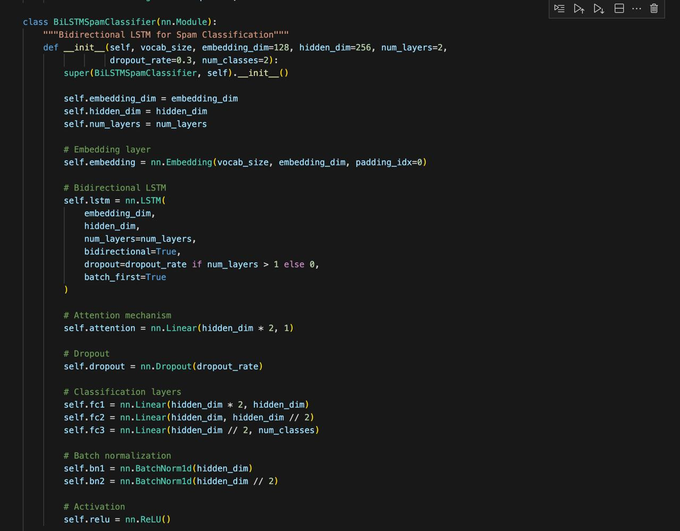
Project Evidence – Bi-directional LSTM Model
IT21812330 | D.L.K.L.Gangaboda | R25-037

Slide 50
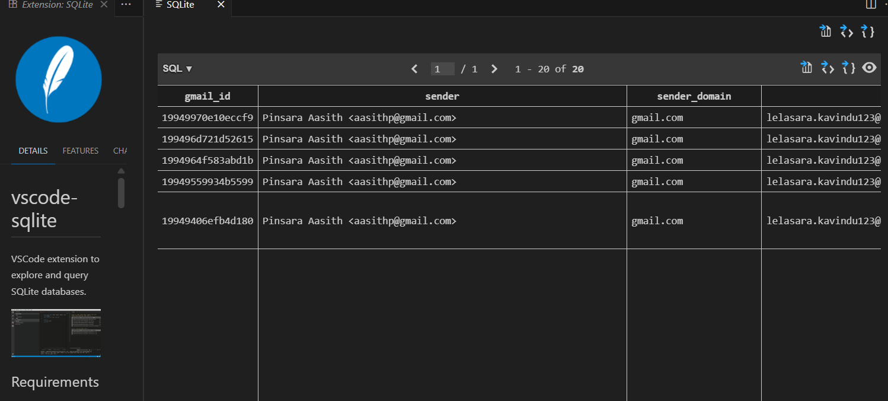
Project Evidence – Database
IT21812330 | D.L.K.L.Gangaboda | R25-037

Slide 51
References
Detecting Spam Emails Using Tensorflow in Python - GeeksforGeeks
What is a Neural Network? - GeeksforGeeks
Spam Email Detection Using Convolutional Neural Networks: An Empirical Study
Bidirectional LSTM in NLP - GeeksforGeeks
MAX POOLING. The pooling operation involves sliding… | by DhanushKumar | Medium
15-206.pdf

Slide 52

IT21825682 | H.P.D.D.M Wickramasinghe
Malware Execution Phase detection using Memory Forensics
IT21825682 | H.P.D.D.M Wickramasinghe | R25-037

Slide 53
Research Question
How can temporal patterns in memory snapshots, derived through memory forensics, be utilized to detect malicious execution during an APT attack?
IT21825682 | H.P.D.D.M Wickramasinghe | R25-037

Slide 54
Research Gap
Despite the growing use of memory forensics in detecting and analyzing advanced persistent threats (APT), there remains a significant gap in applying real-time temporal malware detection for identifying malicious processes running in system memory during the execution phase.
IT21825682 | H.P.D.D.M Wickramasinghe | R25-037

Slide 55
Objective
Develop an advanced malware execution-phase detection framework that leverages memory forensics, temporal modeling, and malware detection to identify and mitigate malicious processes during the execution phase of an APT attack.
IT21825682 | H.P.D.D.M Wickramasinghe | R25-037

Slide 56
Methodology
1. Dataset Collection
Source: Dataset obtained from Kaggle.
Content: Includes memory dump artifacts from both benign systems and systems infected with malware.
Purpose: Provides a comprehensive set of data to train and evaluate the detection model.
2. Preprocessing Pipeline Design
Objective: Clean, extract, and transform raw memory dump data into meaningful features for analysis.
Steps:
Execute Volatility 3 plugins (e.g., pslist, dlllist, malfind) to extract forensic artifacts.
Convert outputs into standardized CSV formats for consistency.
Perform feature engineering to calculate system-level, process-level, and temporal features.
3. Temporal Analysis Using LSTM
Objective: Detect sequential anomalies in memory behavior over time.
Approach:
Utilize LSTM (Long Short-Term Memory) neural networks to model time-series patterns in process behavior.
Capture temporal dependencies and abnormal sequences indicative of malware.
IT21825682 | H.P.D.D.M Wickramasinghe | R25-037

Slide 57
Methodology
4. Mitigation and Response
Objective: Respond to detected threats.
Approach:
Terminate malicious processes identified by the LSTM model.
5. Visualization
Objective: Provide actionable insights to users and security analysts.
Features:
Dashboards showing detected threats, system status, and mitigation actions.
Interactive charts for process activity, anomalies, and predictions.
IT21825682 | H.P.D.D.M Wickramasinghe | R25-037

Slide 58
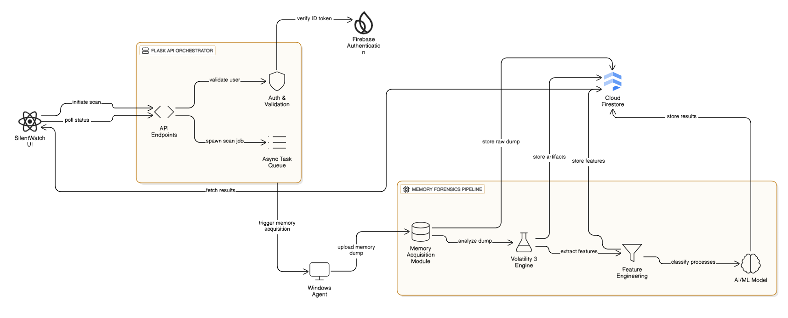
System Architecture
IT21825682 | H.P.D.D.M Wickramasinghe | R25-037

Slide 59
Comparisons
Research | Year | Technique / Model | Dataset | Accuracy
Our System | 2025 | LSTM (Temporal Analysis) | CIC-MalMem-2022 | 94.50%
S. Lee, H. Kim, and H. Y. Lee, “MemoryForensicsNet: Malware Detection from Memory Image Using CNN-LSTM,” ICOIN 2020 | 2020 | CNN-LSTM | Custom | ~92.0%
M. Al-Duwairi, M. Al-Shamaileh, and I. Al-Ma'aitah, “Deep Memory Malware Detection (DMMD) using Deep Neural Networks,” JISA 2021 | 2021 | DNN | Custom | ~90.5%
J. Zhang, H. Yuan, J. Wang, and J. Wu, “Seq-Mal: An LSTM-Based Malware Detection Model Based on Sequential API Call Analysis,” ICIC 2019 | 2019 | RNN | API Call Sequences | ~91.2%
R. M. Nabeel, H. A. A. Al-Wosabi, and A. Z. M. J. Qazaw, “MMCD: Memory Malware Classification and Detection using Machine Learning Techniques,” IJACSA 2022 | 2022 | Random Forest | Custom | ~91.8%
A. Zewei, H. Zhu, and M. Sun, “MIMIR: A Multi-Stage Memory Forensics Framework for Advanced Malware Detection,” ICCSIT 2023 | 2023 | ML (various) | Custom | ~90.0%

Slide 60
Tools and Technology
Memory Forensics Tools: Winpmem, Volatility
Algorithm: LSTM (Long Short-Term Memory) network.
Feature Extraction: Leveraging memory dumps to identify behavioral.
Model Training: TensorFlow / Keras , Jupyter Notebook
Coding: Python, Powershell, React JS, Tailwind CSS
Database: Firebase
Testing: Postman
IT21825682 | H.P.D.D.M Wickramasinghe | R25-037

Slide 61
Requirements
1. Functional Requirements
FR1: Memory Snapshot Acquisition: The system must be capable of acquiring complete physical memory dumps of target windows machines.
FR2: Memory Artifacts Acquisition: The system will be able to scan memory dumps to extract any forensic features, such as process lists, loaded DLLs, network connections, injected code, and hidden processes.
FR3: Preprocessing of Data: The system will pre-process extracted features (processes missing values, normalizes data, forms time-series sequences) in the appropriate machine learning format.
FR4: Malicious Execution Detection: This system uses an LSTM model to evaluate differences in the pattern of a memory state across time and correctly identify a memory state as malicious.
FR5: Analysis in Real-Time: The system should be able to analyze incoming memory snapshots and deliver detection results in near-real-time.
FR6: Threat Visualization: The system will show the detected malicious activity in a dashboard with information about the process, its process tree, and more detailed memory insights.
FR7: User-Mitigation: The system will have a terminate button on the dashboard that security analysts can use to terminate malicious processes detected by the system.
FR8: Historical Data Storage: The system will be configured to store the results of historical analysis and detection logs and system metrics in a Firebase database to be reviewed.
IT21825682 | H.P.D.D.M Wickramasinghe | R25-037

Slide 62
Requirements
2. Non - Functional Requirements
NFR1: Accuracy: The detection module will have a high rate of accuracy (target >90%), in distinguishing between benign and malicious memory states.
NFR2: Small False Positive Rate: The system will have a low false positive rate to reduce alert fatigue amongst security analysts.
NFR3: Performance/Latency: The time between the acquisition of memory snapshot to displaying the detection result on the dashboard must be reduced to the minimum possible to allow timely response.
NFR4: Scalability: The system architecture will be capable of monitoring a variety of endpoints at once.
NFR5: Reliability: The system will be operational, reliable without frequent crashes or faults.
NFR6: Usability: The user interface will be user friendly and intuitive to security professionals.
NFR7: Security: The data communication between the components and storage in Firebase will be secure.
IT21825682 | H.P.D.D.M Wickramasinghe | R25-037

Slide 63
Dataset
The CIC-MalMem-2022 dataset is a balanced and labeled dataset designed for detecting obfuscated malware through memory analysis. It contains 58,596 memory dump records with 56 engineered features and an equal split of 29,298 benign and 29,298 malicious samples. Malicious samples span 15 malware families across Spyware, Ransomware, and Trojan Horse categories, simulating real-world attack scenarios. [1]
IT21825682 | H.P.D.D.M Wickramasinghe | R25-037

Slide 64
Current Progress
Algorithm Selection.
Training Pipeline.
Feature Importance Analysis.
Model Evaluation.
Testing on Trained Model.
Feature Extraction from real time memory dumps.
Preprocessing Extracted Features.
Model Integration with Backend.
Frontend and backend Development.
IT21825682 | H.P.D.D.M Wickramasinghe | R25-037

Slide 65
Future Work
Fixing of Errors
Fine tuning the Alerts

Slide 66
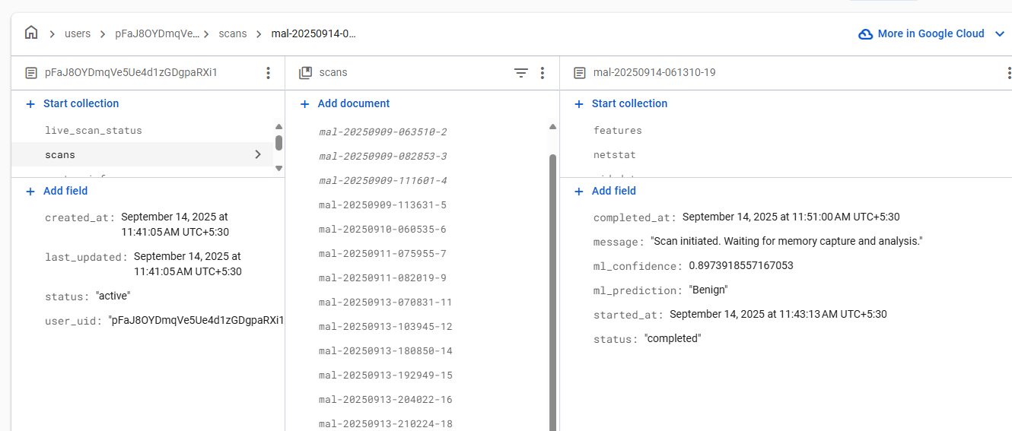
Evidences -Database
IT21825682 | H.P.D.D.M Wickramasinghe | R25-037

Slide 67
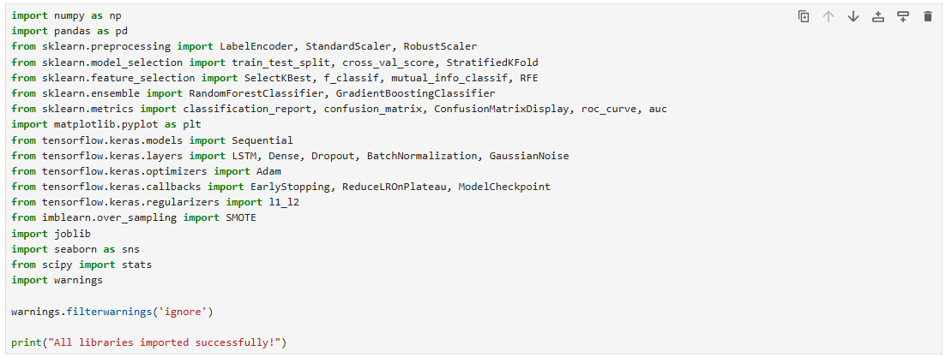
Evidences - Imports
Data Manipulation (pandas, numpy)
Preprocessing (sklearn.preprocessing)
Model Building (tensorflow, sklearn.ensemble)
Evaluation (sklearn.metrics)
Visualization (matplotlib, seaborn).
IT21825682 | H.P.D.D.M Wickramasinghe | R25-037

Slide 68
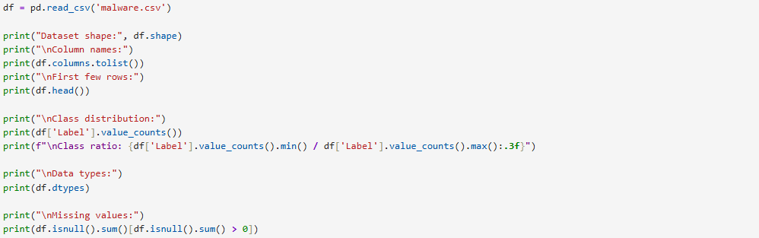
Evidences
Dataset is loaded, checking its structure, examining class distribution, and identifying missing values.
IT21825682 | H.P.D.D.M Wickramasinghe | R25-037

Slide 69
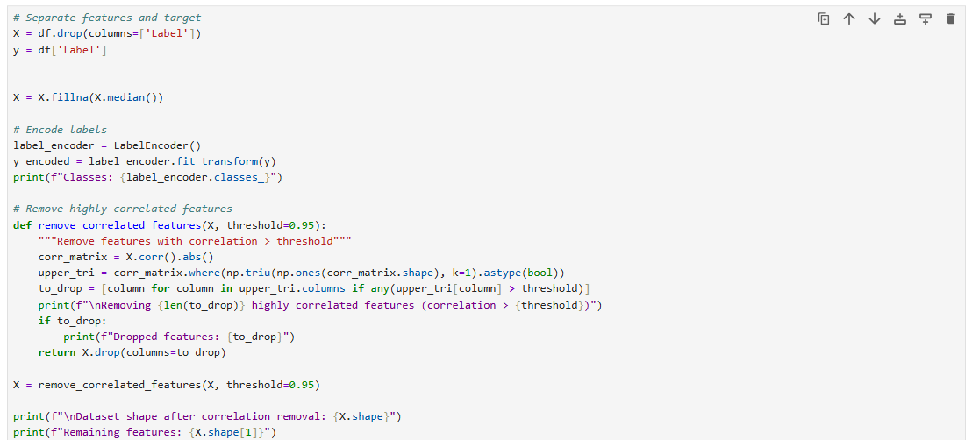
Evidences
Prepares data for a machine learning model by separating features from the target variable(y), filling missing values with the median, encoding labels, and removing highly correlated features because they provide redundant information to the model.
IT21825682 | H.P.D.D.M Wickramasinghe | R25-037

Slide 70
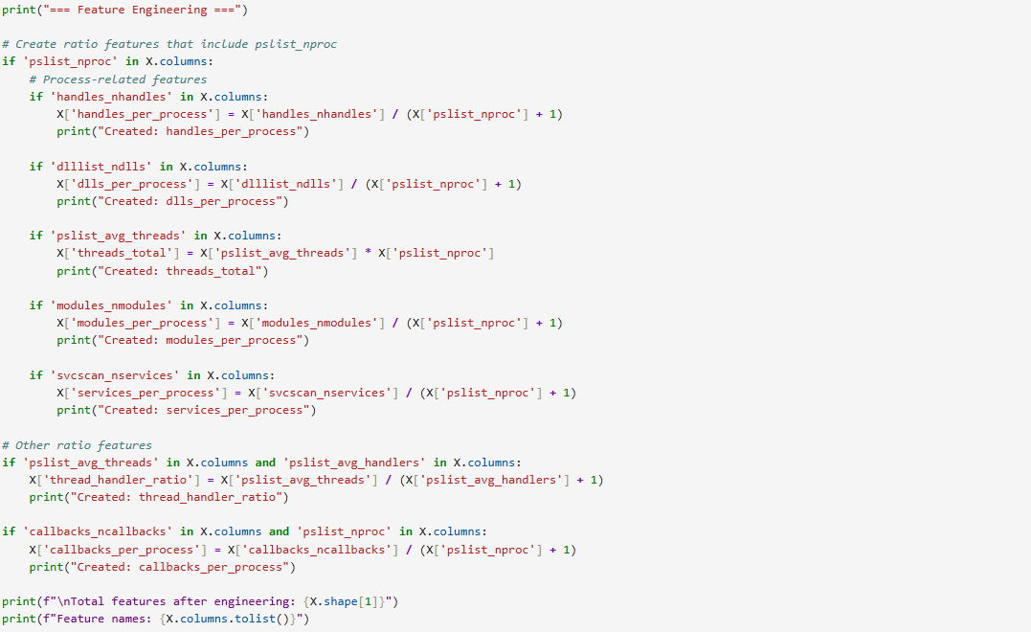
Evidences
Feature engineering by creating new ratio-based features and derived values from existing columns, such as counts per process, to provide more meaningful information for the model.
The engineered features created are:
handles_per_process
dlls_per_process
threads_total
modules_per_process
services_per_process
thread_handler_ratio
callbacks_per_process
IT21825682 | H.P.D.D.M Wickramasinghe | R25-037

Slide 71
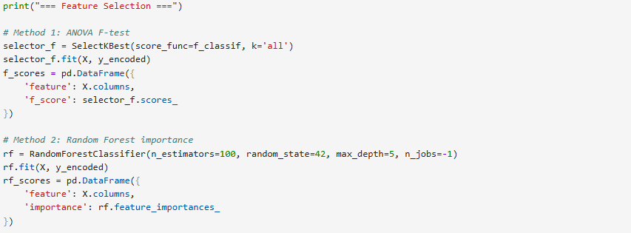
Evidences
Feature selection by evaluating the importance of each feature.
The ANOVA F-test is a basic check that finds features that are individually good at predicting the outcome.
The Random Forest method is a more powerful check that finds features that work well together as a group to predict the outcome.
IT21825682 | H.P.D.D.M Wickramasinghe | R25-037

Slide 72
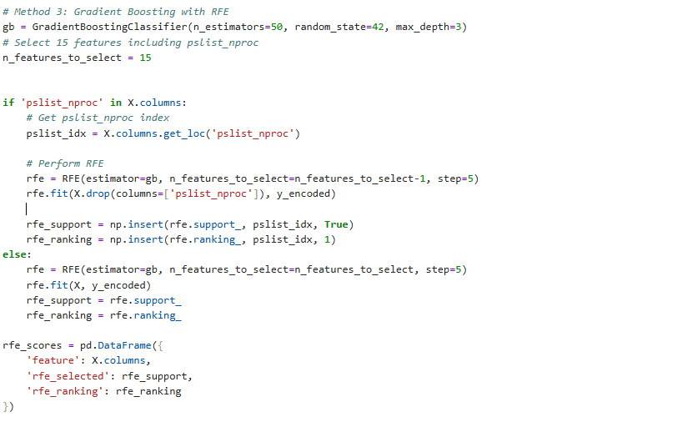
Evidences
Recursive Feature Elimination (RFE), using a Gradient Boosting Classifier to iteratively select the top 15 most important features.
IT21825682 | H.P.D.D.M Wickramasinghe | R25-037

Slide 73
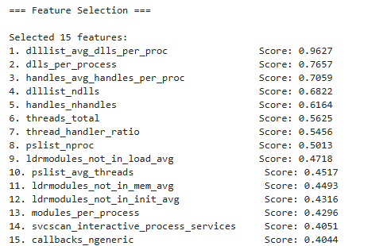
Evidences
IT21825682 | H.P.D.D.M Wickramasinghe | R25-037

Slide 74
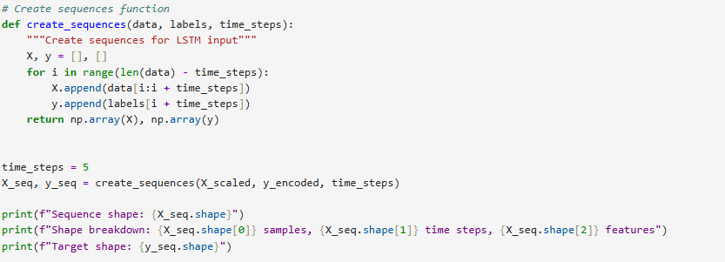
Evidences
Defines a function, create_sequences, that prepares a dataset for an LSTM (Long Short-Term Memory) neural network by transforming it into a sequence format, where each input X is a series of data points and the corresponding output y is the next data point in the sequence.
IT21825682 | H.P.D.D.M Wickramasinghe | R25-037

Slide 75
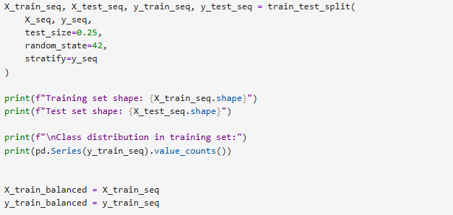
Evidences
The train_test_split function divides the sequential data into training and testing sets, using the stratify parameter to ensure both sets maintain a class distribution proportionate to the original dataset.
IT21825682 | H.P.D.D.M Wickramasinghe | R25-037

Slide 76
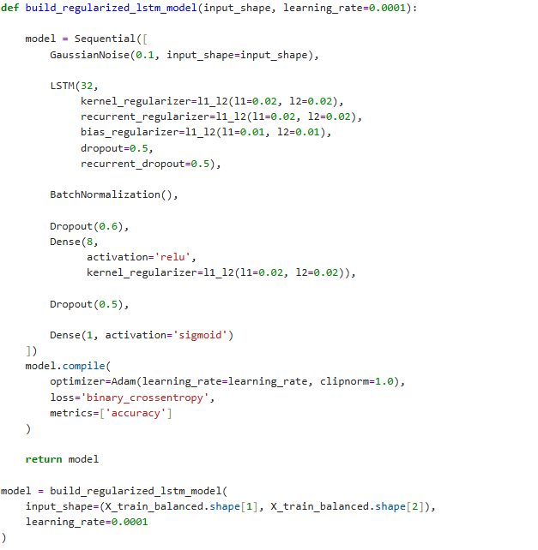
Evidences
Defines and compiles a regularized LSTM neural network using TensorFlow/Keras to perform binary classification. The model's architecture is built with layers specifically chosen to handle sequential data and overcome overfitting, including a GaussianNoise layer for input stability, LSTM layers with built-in regularization, and Dropout layers to prevent reliance on specific neurons. The model is then compiled with the Adam optimizer and binary cross-entropy loss, which are standard choices for efficiently training a classifier on a binary target.
IT21825682 | H.P.D.D.M Wickramasinghe | R25-037
Notes:
To make the model smarter and prevent it from memorizing the training data, the script uses special techniques (called regularization). These are like adding noise or randomly turning off parts of the model during training, forcing it to learn the most important patterns instead of minor details. Finally, the model is given a "coach" (Adam optimizer) to help it learn efficiently and a "scorekeeper" (binary cross-entropy loss) to tell it how well it's doing.

Slide 77
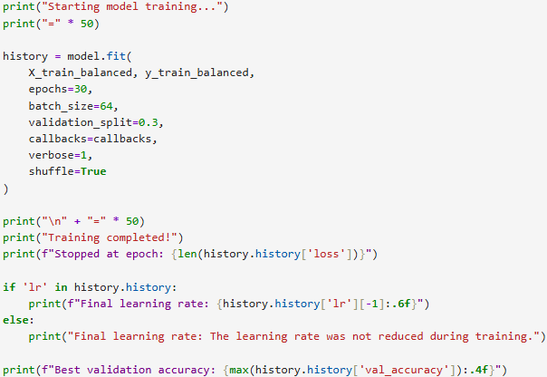
Evidences
Training of a machine learning model using the model.fit() function with specific parameters for epochs, batch size, and validation, and then prints a summary of the training results, including the final learning rate and best validation accuracy.
IT21825682 | H.P.D.D.M Wickramasinghe | R25-037
Notes:
The most important values are used to prevent the model from overfitting, which is when it learns the training data too well and performs poorly on new data.
The validation_split=0.3 sets aside 30% of the data as a "test set" that the model never trains on.
The epochs=30 sets a maximum number of times the model will see the entire dataset.

Slide 78
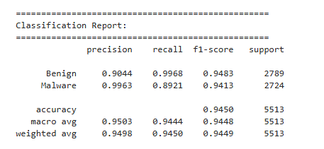
Evidences
IT21825682 | H.P.D.D.M Wickramasinghe | R25-037
Notes:
Precision: Out of all the instances the model predicted as a certain class, how many were correct? The model has a very high precision for the Malware class (0.9963), meaning that when it flags something as malware, it's almost always correct, resulting in very few false alarms.
Recall: Out of all the actual instances of a certain class, how many did the model correctly identify? The model's recall for Malware is 0.8921, meaning it correctly found about 89% of all the actual malware, but it missed roughly 11%. It has an extremely high recall for the Benign class, meaning it rarely misclassifies a benign file as malware.
F1-Score: This is a single score that balances both precision and recall.
Support: The number of samples for each class in the dataset. The dataset is nearly balanced with 2789 benign instances and 2724 malware instances.
Accuracy: The overall percentage of correct predictions made by the model, which is a very high 94.50%.

Slide 79
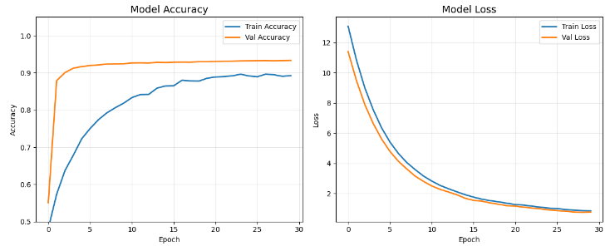
Evidences
IT21825682 | H.P.D.D.M Wickramasinghe | R25-037
Notes:
The charts display the training history of a neural network, showing that the model's accuracy and loss both improved as the number of epochs increased, with the model performing slightly better on the validation data than on the training data.

Slide 80
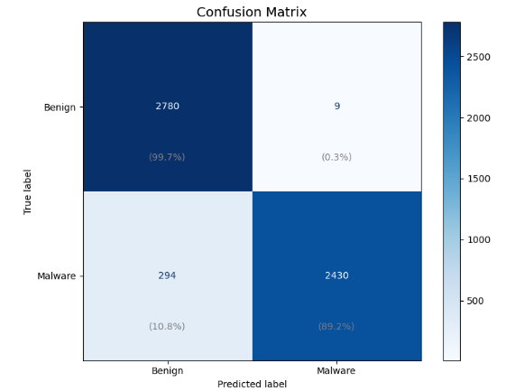
Evidences – Confusion Matrix
IT21825682 | H.P.D.D.M Wickramasinghe | R25-037
Notes:
Top-Left (2780): The model correctly identified 2780 instances as Benign when they were, in fact, benign (99.7% of all actual benign files).
Top-Right (9): The model incorrectly predicted 9 instances as Malware when they were actually benign. These are false positives or "false alarms."
Bottom-Left (294): The model incorrectly predicted 294 instances as Benign when they were actually malware. This is a false negative, meaning the model failed to detect this malware.
Bottom-Right (2430): The model correctly identified 2430 instances as Malware when they were, in fact, malware (89.2% of all actual malware).

Slide 81
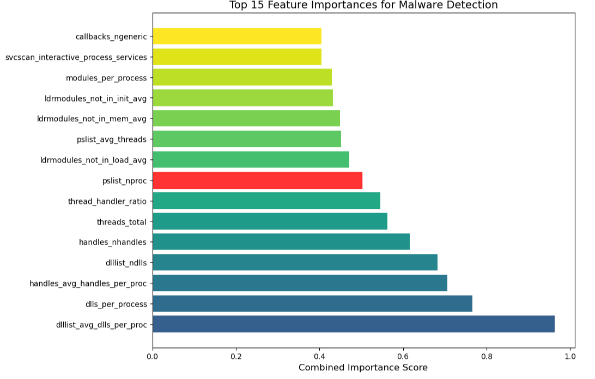
Evidences
IT21825682 | H.P.D.D.M Wickramasinghe | R25-037

Slide 82
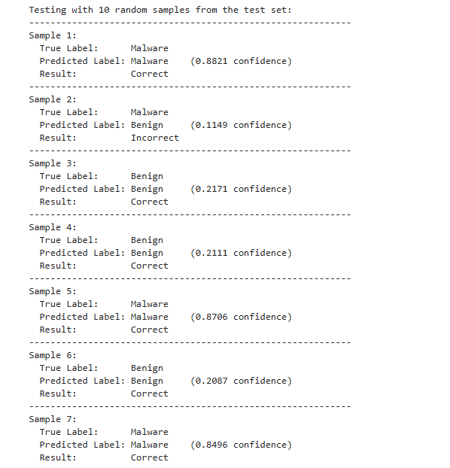
Evidences
IT21825682 | H.P.D.D.M Wickramasinghe | R25-037

Slide 83
References
[1] Malware Memory Analysis | Datasets | Canadian Institute for Cybersecurity | UNB
IT21825682 | H.P.D.D.M Wickramasinghe | R25-037

Slide 84


Slide 85
Thank You

